Slide 1
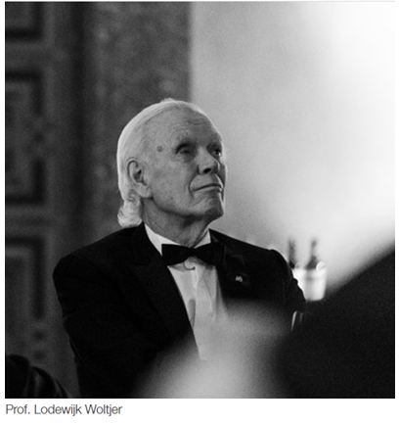
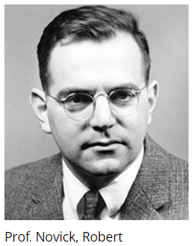
Columbia Astrophysics Laboratory (CAL) was founded by Professor of Astronomy, Lo Woltjer and Professor of Physics, Robert Novick in 1967.
CAL is the administrative unit charged with supporting the research effort in Astrophysics at Columbia University.
All external research grants are administered by the Laboratory administrative staff and units.
COLUMBIA UNIVERSITY
IN THE CITY OF NEW YORK

Slide 2
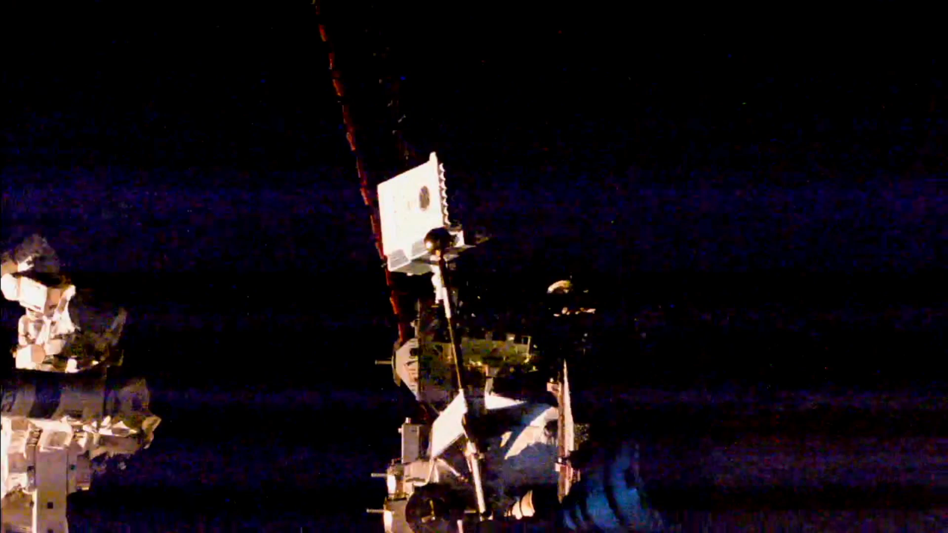
COLUMBIA ASTROPHYSICS LABORATORY
The Neutron Star Interior Composition Explorer

Slide 3
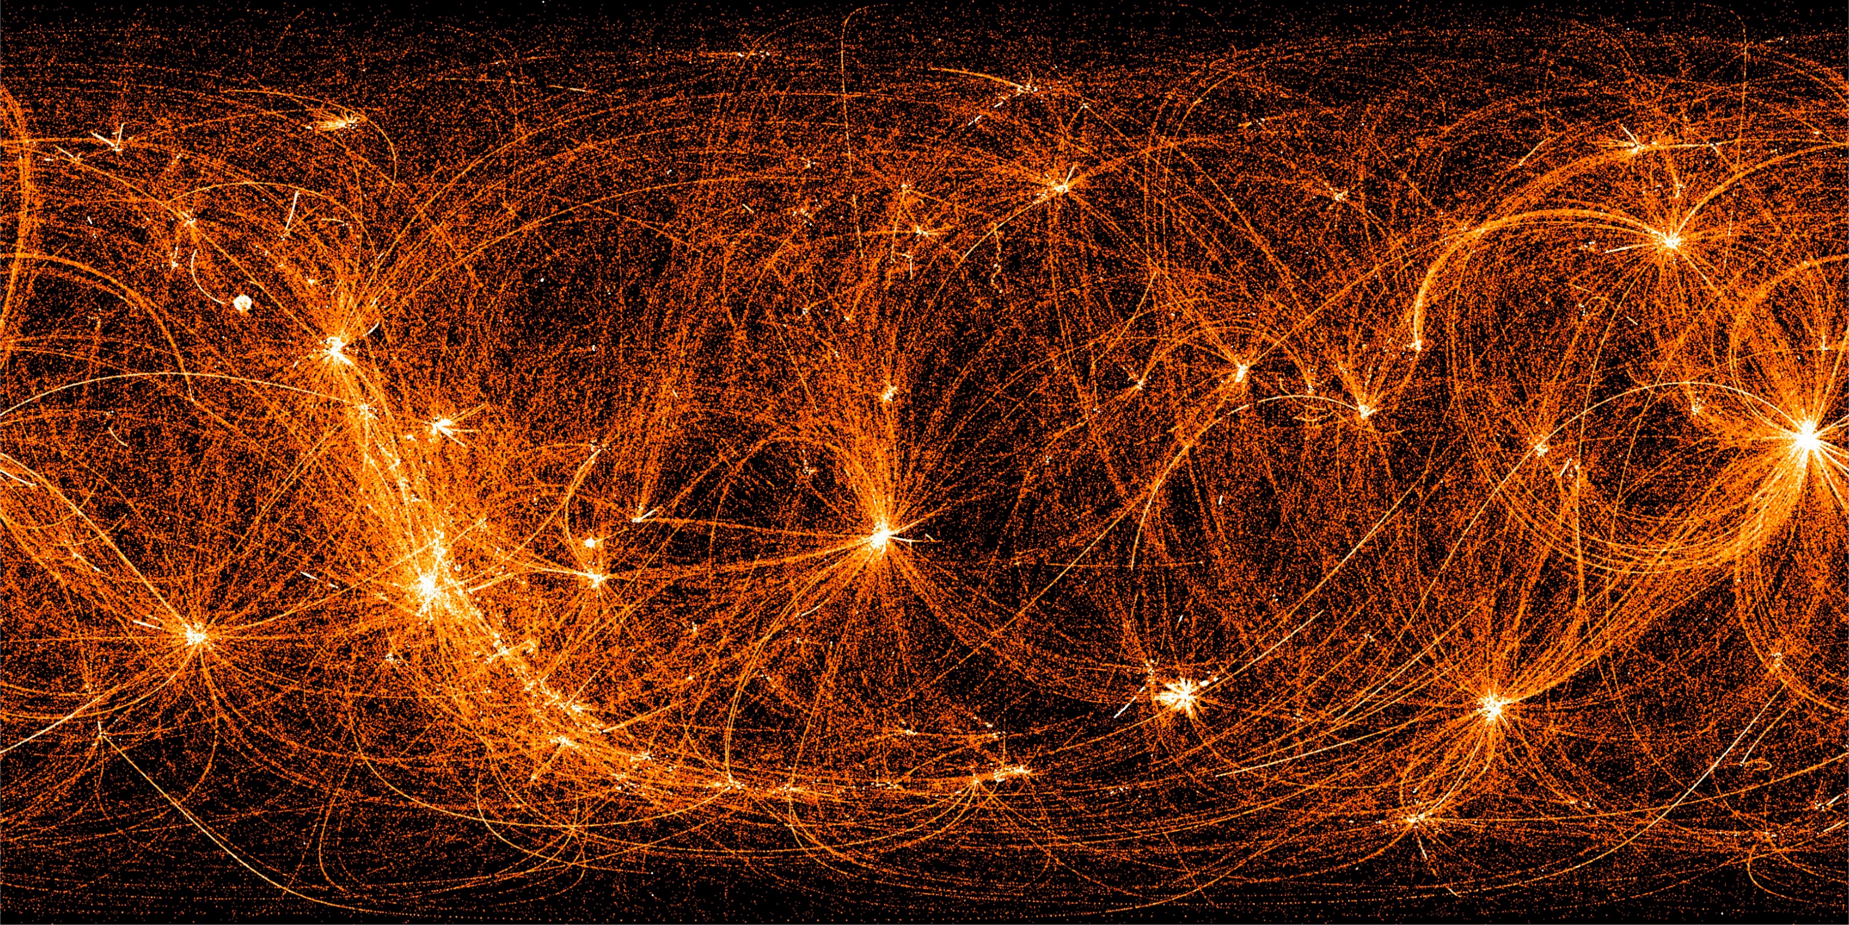
COLUMBIA ASTROPHYSICS LABORATORY
The NICER Night Sky

Slide 4
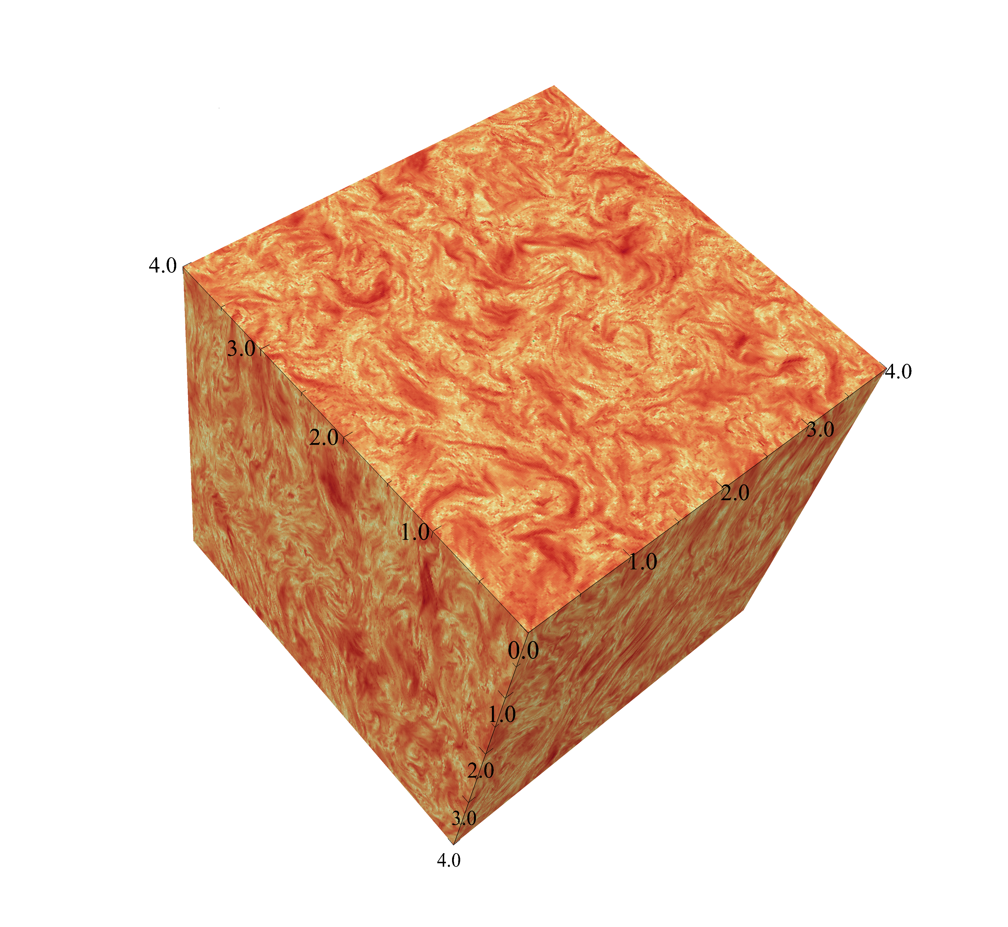
COLUMBIA ASTROPHYSICS LABORATORY
Turbulent velocity field from a kinetic simulation of relativistic plasma turbulence

Slide 5
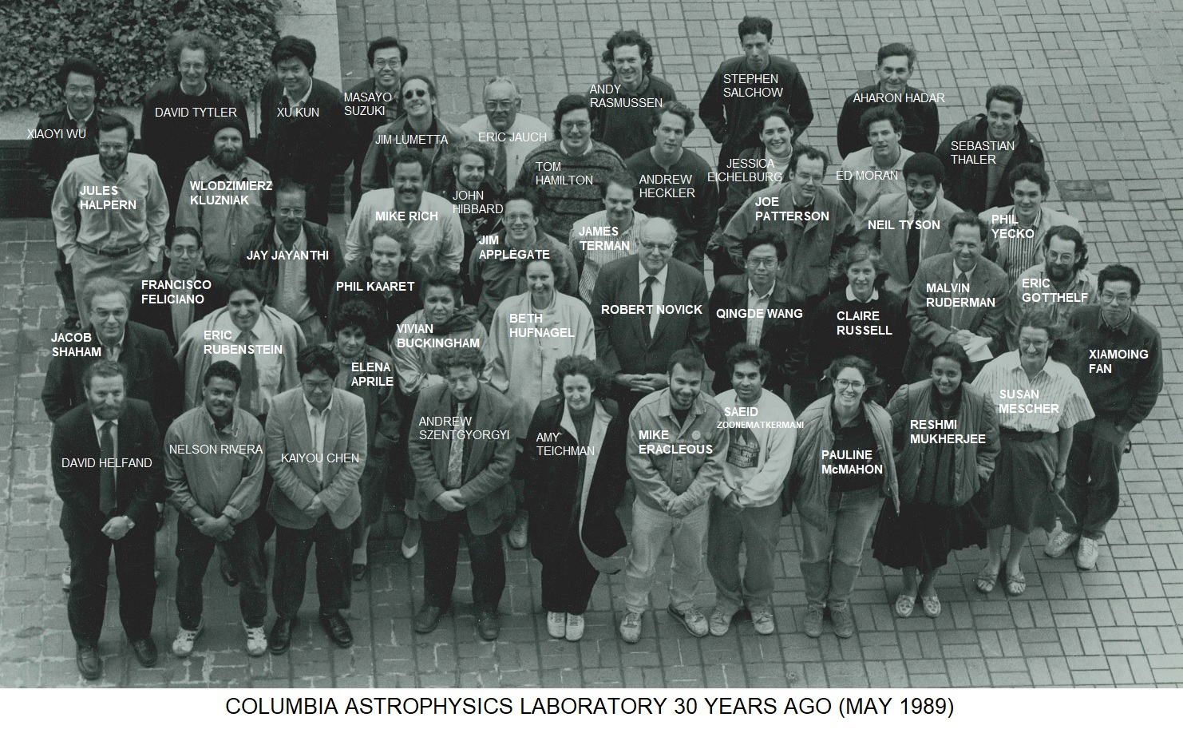

Slide 6
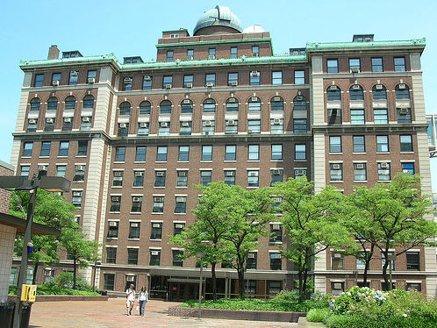
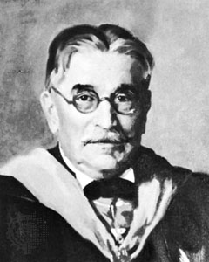
PUPIN HALL
The building was erected in 1925 and named Pupin Hall, in honor of Michael Idvorsky Pupin, after his death in 1935.
Michael Pupin was one of the greatest inventors of his time and a professor of Physics at Columbia University.
COLUMBIA UNIVERSITY
IN THE CITY OF NEW YORK

Slide 7
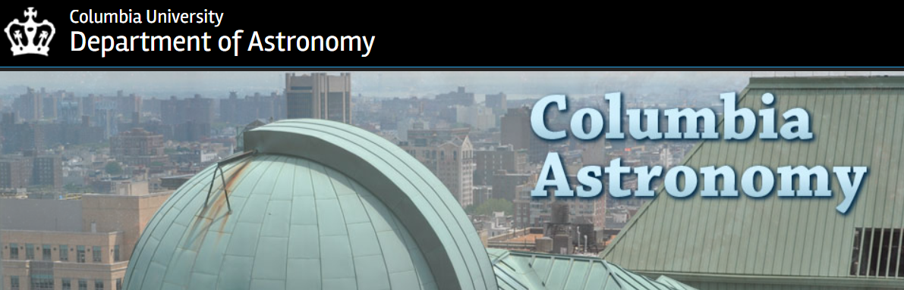


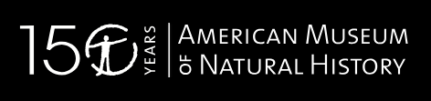
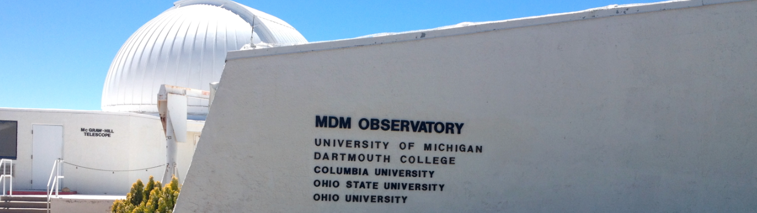
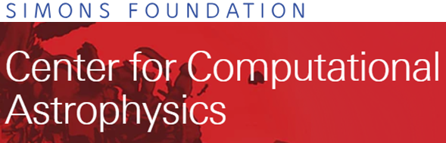

Institutional Components

Slide 8
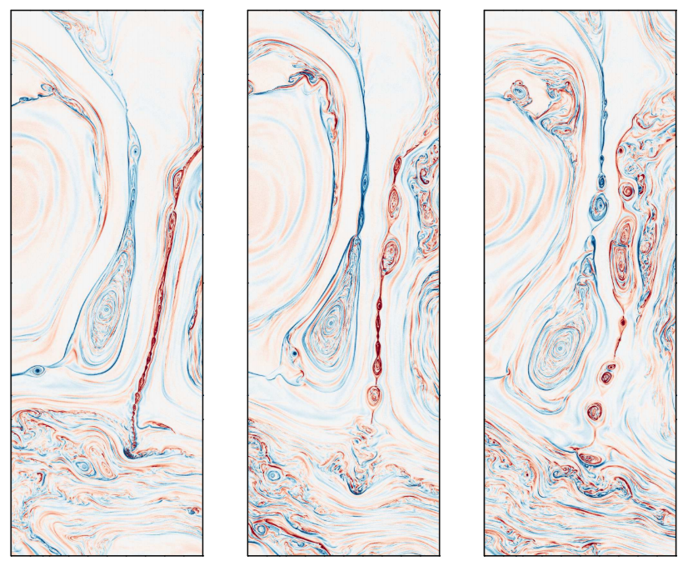
Electric current density in a simulation of plasma turbulence, showing the formation of plasmoids due to magnetic reconnection in the turbulent environment

Slide 9
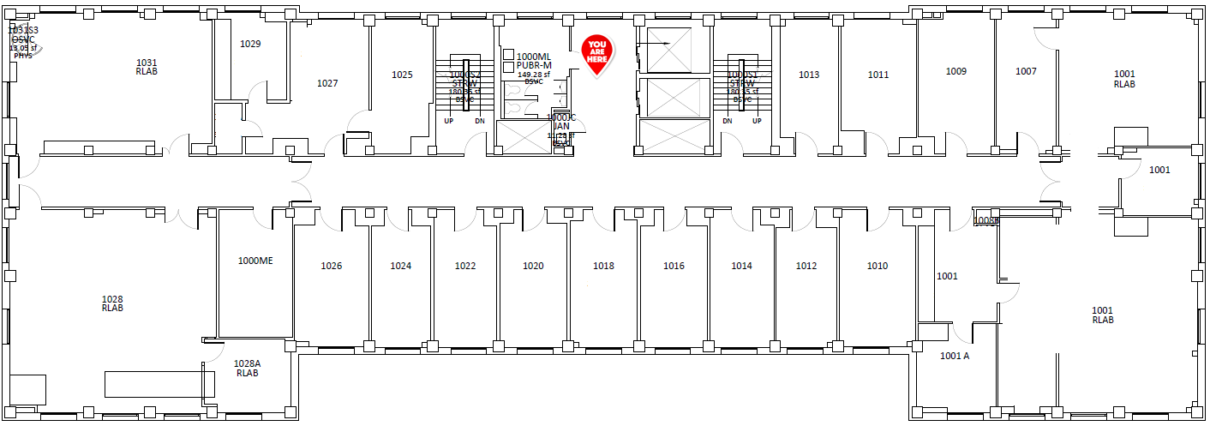
Gertrude Reyes Human Resources
Muamer Lihic
Director Admin. & Fin.
Samantha Santiago Procurements
Francisco Feliciano Grants Management
David Secrest Information Technology
ADMINISTRATIVE STAFF
Columbia Astrophysics Laboratory – 10th floor

Slide 10
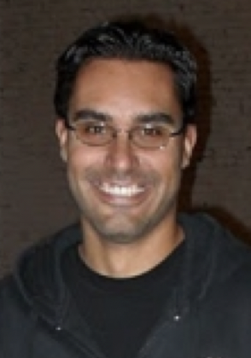
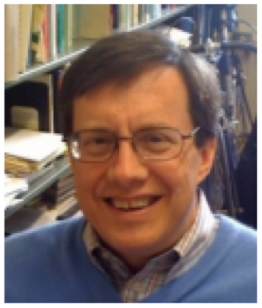
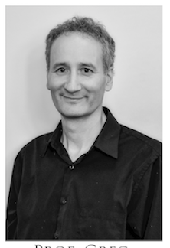
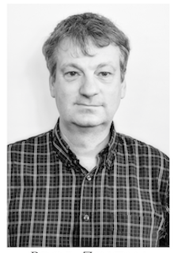
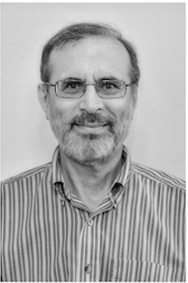
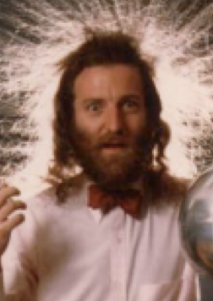
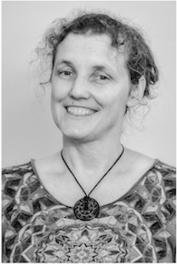
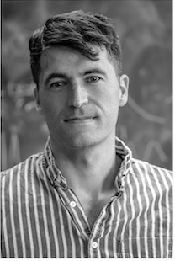
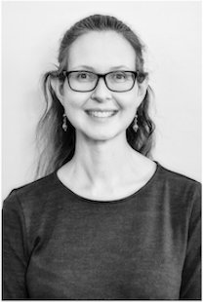
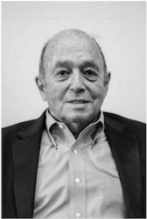
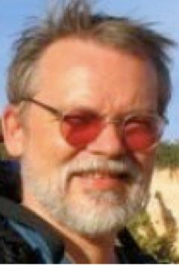
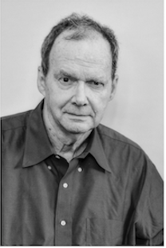
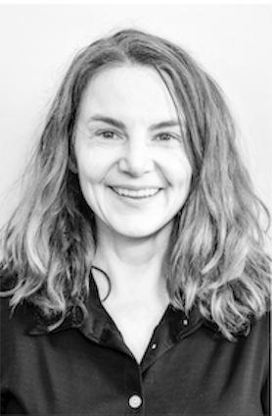
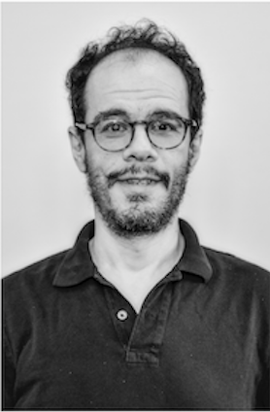
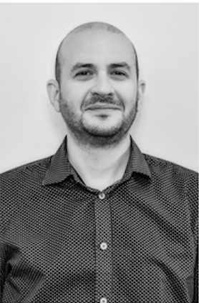
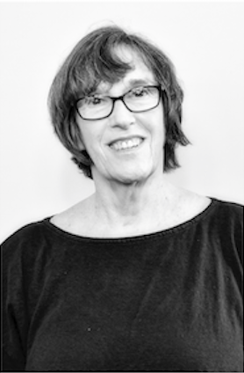
Faculty
Marcel
Agüeros
1327
Jim
Applegate
1322
Greg
Bryan
1325
Zoltan
Haiman
1326
Jules
Halpern
1014
David
Helfand
1020
Kathryn
Johnston
1320
David
Kipping
1331
Melissa
Ness
1325
Jerry
Ostriker
1024
Frits
Paerels
1022
Joe
Patterson
1422
Mary
Putman
1318
David
Shiminovich
1324
Lorenzo
Sironi
1012
Jacqueline
Van Gorkom
1420
Columbia Astrophysics Laboratory Office – Room 1027

Slide 11
Jeremiah P. Ostriker
Professor of Astronomy
Charles J. Hailey
Pupin Professor
of Physics
Co-Director CAL
Jules Paul Halpern
Professor of Astronomy
Eric V. Gotthelf
Senior Research Scientist
Slavko Bogdanov
Associate Research Scientist
Frederik B. Paerels
Professor of Astronomy
David John Helfand
Professor of Astronomy
Statia H. L. Cook
Lecturer in Astronomy
Azadeh Keivani
Lecturer in Physics
Luca Comisso
Postdoctoral Research Scientist
Eric Robert Coughlin
Postdoctoral Research Scientist
Lorenzo Sironi
Assistant Professor of Astronomy
Columbia Astrophysics Laboratory – 10th floor

Slide 12
Thomas Brian Humensky
Associate Professor of Physics
Szabolcs Marka
Walter O. LeCroy, Jr. Professor of Physics
Guillaume Plante
Associate Research Scientist
Marcela Stern
Senior Staff Associate
Postdoctoral Research Scientists: Fei Gao, Masatoshi Kobayashi, Qing Lin
Graduate Research Assistants: Joseph Howlett, Yun Zhang, Tianyu Zhu
Caleb A. Scharf
Senior Lecturer in Astronomy
Elena Aprile
Professor of Physics
Columbia Astrophysics Laboratory – 10th floor

Slide 13
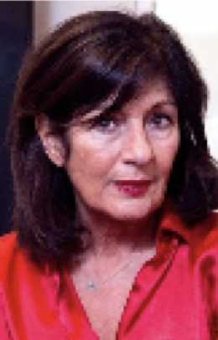
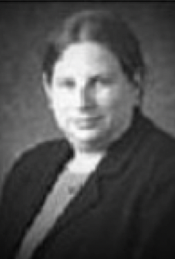
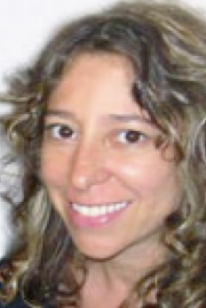
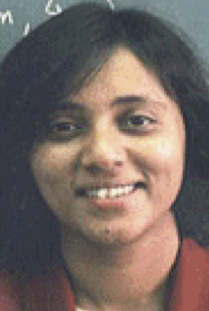
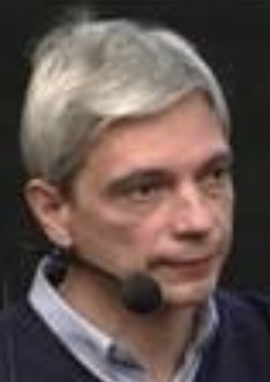
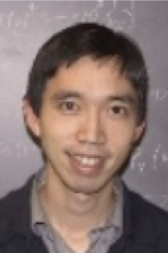
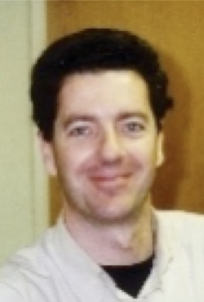
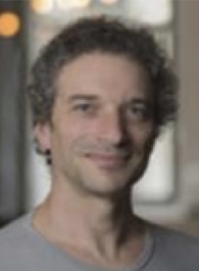
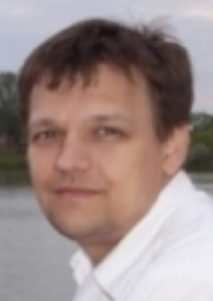
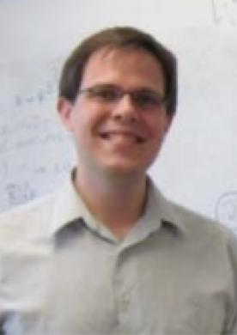
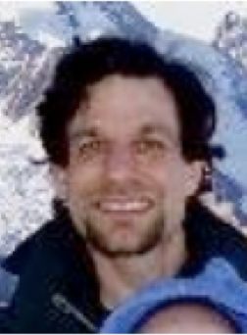
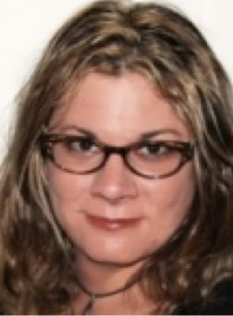
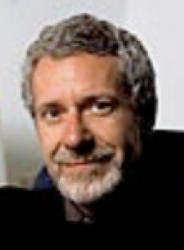
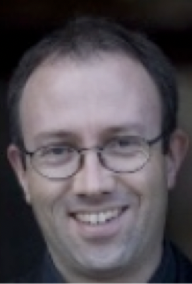
Affiliated Faculty
Barnard
Physics
Brian
Metzger
Laura
Kay
Reshmi
Mukherjee
Szabolcs
Marka
Janna
Levin
Chuck
Hailey
Lam
Hui
Elena
Aprile
Andrei
Beloborodov
Yuri
Levin
American Museum of Natural History
Other Columbia Astrophysics Laboratory
Mordecai
Mark
MacLow
Rebecca
Oppenheimer
Michael
Shara
Caleb
Scharf
Astronomy Department Office – Room 1328

Slide 14
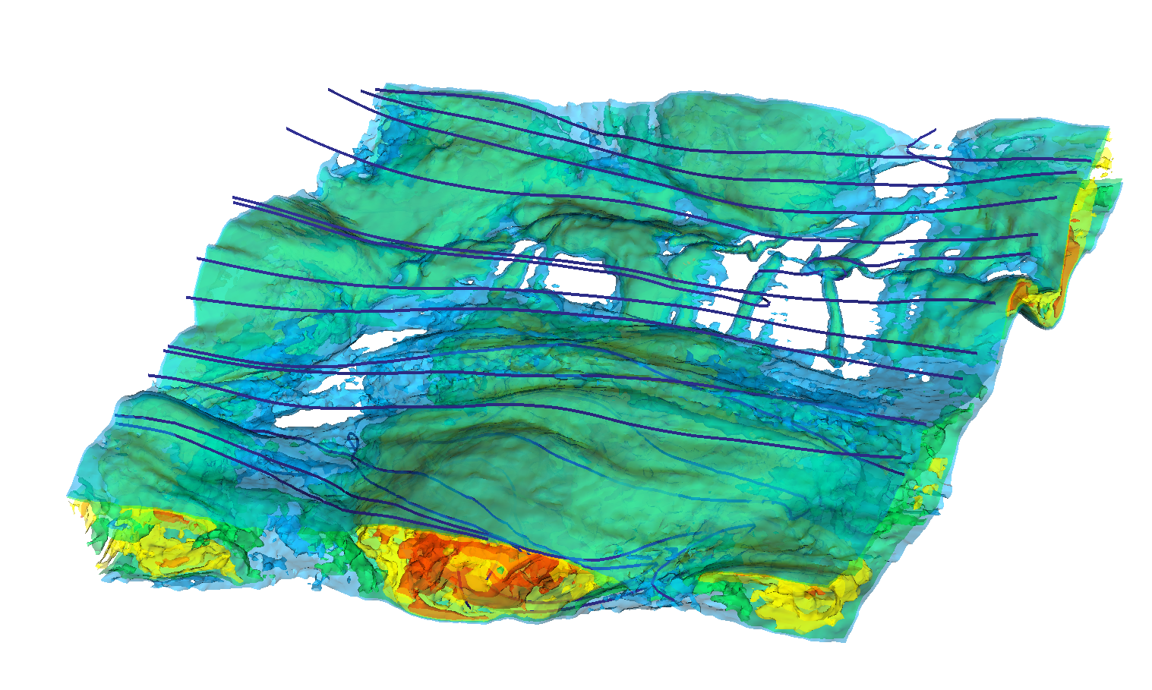
COLUMBIA ASTROPHYSICS LABORATORY
Isocontours of the particle density,
showing the formation
of flux ropes during
magnetic
reconnection.

Slide 15
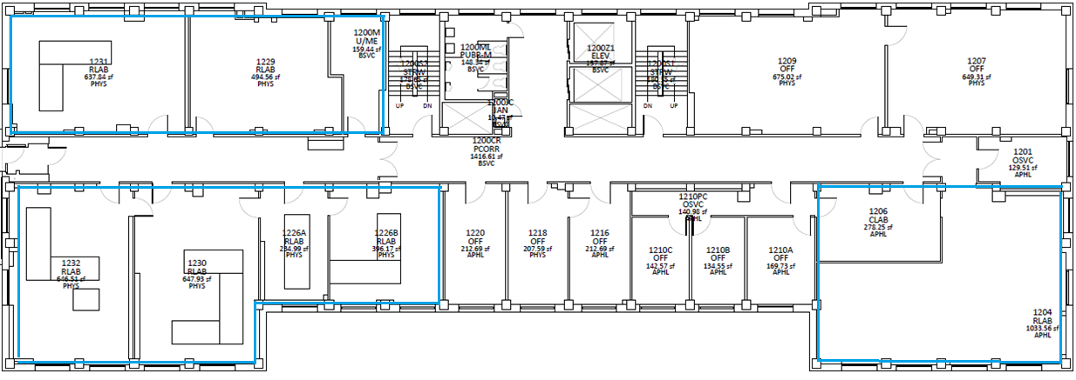
Kaya Mori
Associate Research Scientist
Prof. Hailey Students:
Amani Garvin
Yvette Schutt
Brian Smallshaw
Michael Hahn
Research Scientist
Prof. Marka GECo Lab
Prof. Hailey Lab
Evan Martinez
Nathan Saffold
Cianci Melo-Carrillo
Prof. Schiminovich Lab
Brian Smiley
Mechanical Technician
Nicole Melso
Graduate Research Assistant
Hwei Ru Ong
Staff Associate
Barbara Cruvinel Santiago
Graduate Research Assistant
Zsuzsanna Marka
Associate Research Scientist
Students:
Doga Veske
Stefan Countryman
Rainer Corley
Sayak Bose
Postdoctoral Research Scientist
Kyle Bowen
Postdoctoral Research Scientist
Ruitian Zhang
Associate Research Scientist
Daniel Savin
Senior Research Scientist
Columbia Astrophysics Laboratory – 12th floor

Slide 16
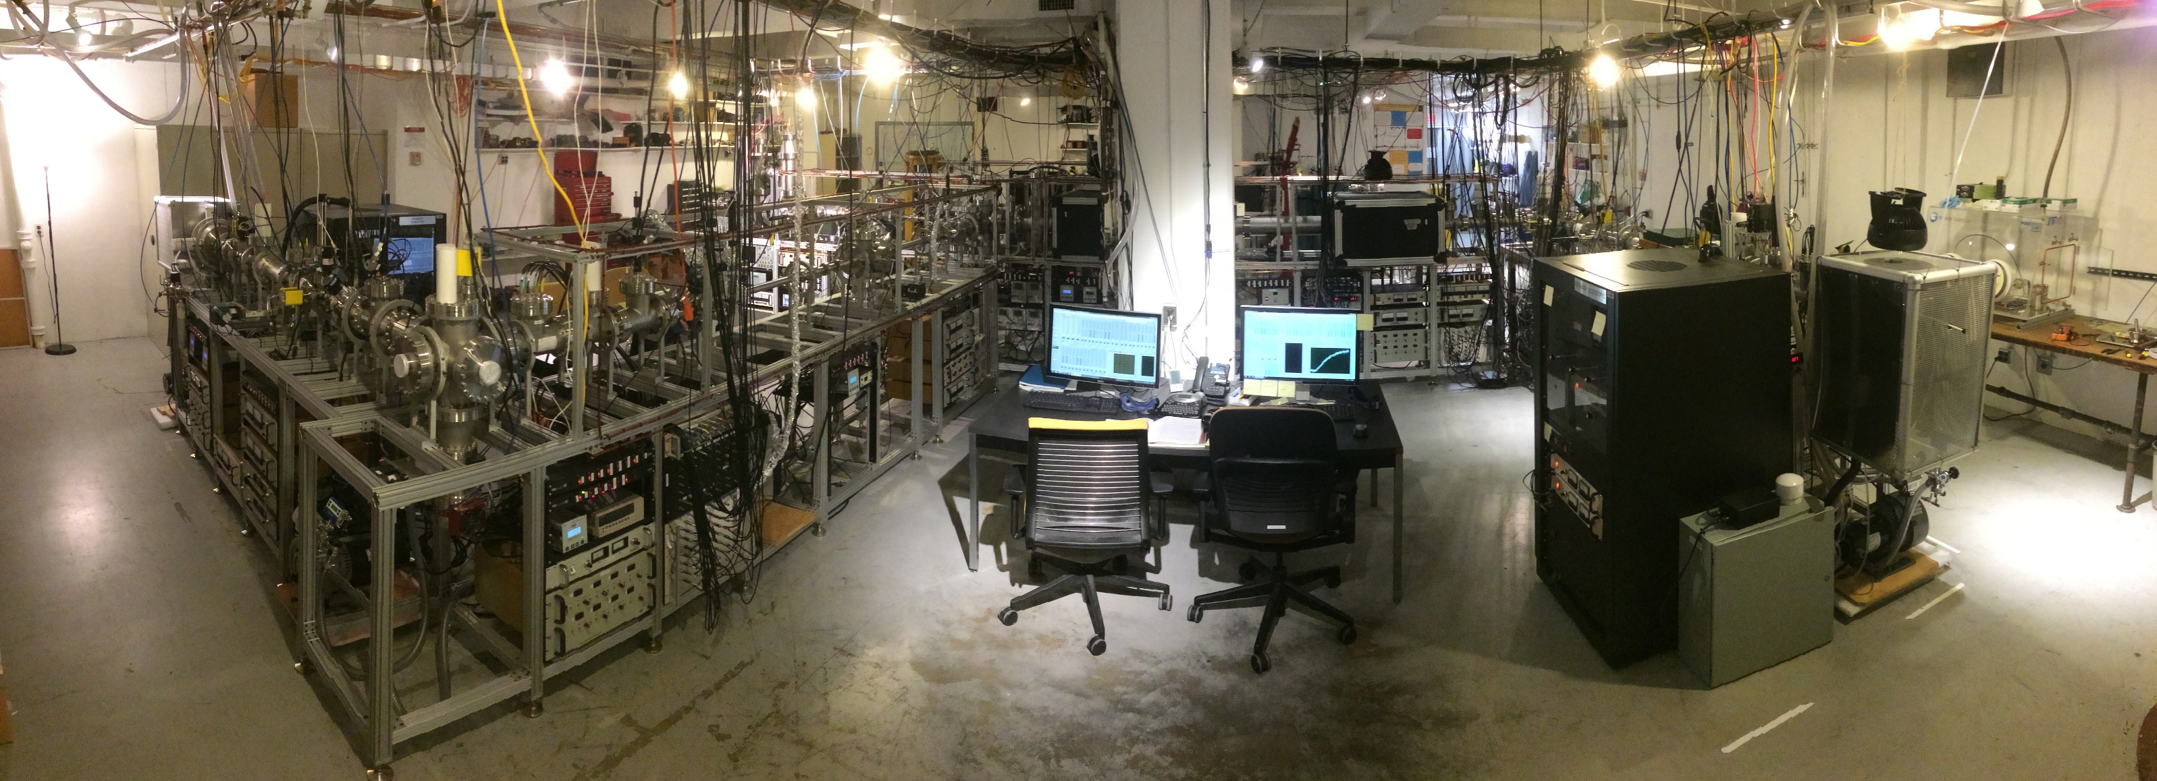
The Savin laboratory is located at Nevis Laboratories in Irvington, NY. The group studies in the laboratory various astrochemically important reactions, ranging from those that formed some of the first organic molecules to others that lead to the formation of stars.
NEVIS campus – THE SAVIN LABORATORY

Slide 17
Upcoming Event - Colloquium Lessons from the History of Physical Cosmology (Big Apple Colloquium) James Peebles, Princeton University February 28, 2020 3:00 pm Location: Davis auditorium (TBC) Host: Zoltan Haiman

Slide 18
Upcoming Event - Colloquium Blast from the Past: Impact of Ultraviolet Emission and Flaring on Exoplanetary Systems and their Habitability Evgenya Shkolnik, Arizona State University March 4, 2020 4:05 pm Location: 1402 Pupin Host: Marcel Agüeros

Slide 19
Upcoming Event - Colloquium TBA - Foucart Francois Foucart, UNH March 11, 2020 4:05 pm Location: TBD Host: Lorenzo Sironi

Slide 20
Upcoming Event - Public Talk and Stargazing Heart of Darkness: Unraveling the Mysteries of the Invisible Universe Jerry Ostriker March 13th, 2020 8pm 301 Pupin Hall

Slide 21
Upcoming Event - Public Talk and Stargazing Heart of Darkness: Unraveling the Mysteries of the Invisible Universe Jerry Ostriker March 13th, 2020 8pm 301 Pupin Hall

